Slide 1
COVID-19 Spread By Race and Age
Amanuel Challa
Akuete Akwei
Mike Darius Achianga

Slide 2
According to CDC, among 580 hospitalized COVID-19 patients with race/ethnicity data, approximately 45% were white, 33% were black, and 8% were Hispanic, suggesting that black populations might be disproportionately affected by COVID-19.
Among 1,968 cases with information on race/ethnicity, 43.4% were non-Hispanic white, 32.0% were non-Hispanic black, 11.7% were Hispanic and 12.9% were other race, including unknown race.

Slide 3
COVID19 Cases In US by Race Breakdown
Among 1,968 cases with information on race/ethnicity, 43.4% were non-Hispanic white, 32.0% were non-Hispanic black, 11.7% were Hispanic and 12.9% were other race, including unknown race. https://www.cdc.gov/coronavirus/2019-ncov/covid-data/covidview/index.html?CDC_AA_refVal=https%3A%2F%2Fwww.cdc.gov%2Fcoronavirus%2F2019-ncov%2Fcovid-data%2Fcovidview.html
 | Overall | 0-4 years | 5-17 years | 18-49 years | 50-64 years | 65+ years
 | N (%) | N (%) | N (%) | N (%) | N (%) | N (%)
Non-Hispanic White | 854 (43.4) | 3 (60.0) | 3 (33.3) | 136 (29.2) | 239 (37.5) | 473 (55.6)
Non-Hispanic Black | 630 (32.0) | 0 (0.0) | 6 (66.7) | 158 (34.0) | 229 (35.9) | 237 (27.8)
Hispanic | 230 (11.7) | 2 (40.0) | 0 (0.0) | 107 (23.0) | 82 (12.9) | 39 (4.6)
Other | 254 (12.9) | 0 (0.0) | 0 (0.0) | 64 (13.8) | 88 (13.8) | 102 (12.0)

Slide 4
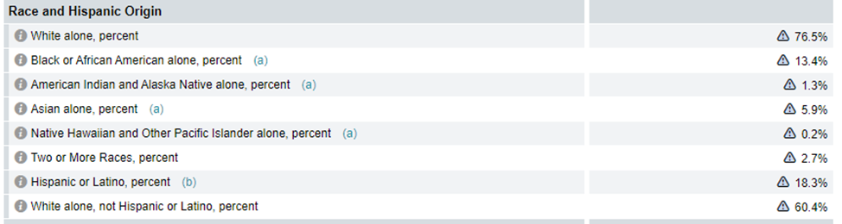
Race Demographic in united states

Slide 5
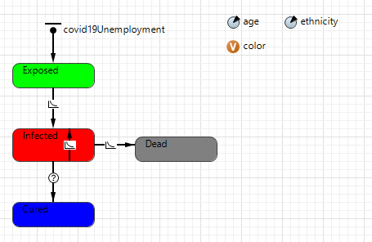
Using Agent Base Modeling In AnyLogic we Derived some initial conditions
An individual agent has age and race based on the demographic statistic of the united states
Agents have four different states based on a given rate

Slide 6
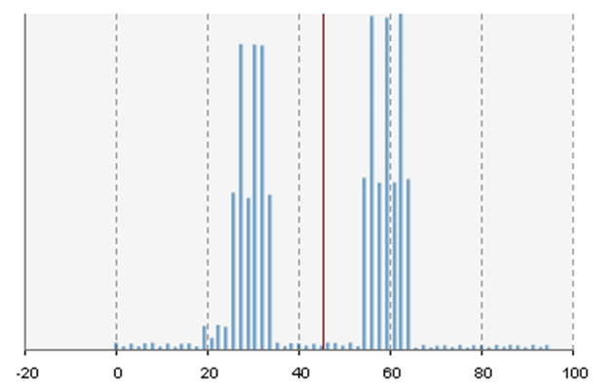
Age Distribution of agents in the simulation Population

Slide 7
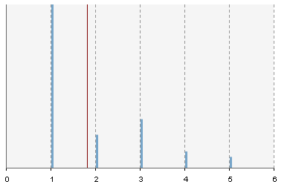
Age Distribution of agents in the simulation Population
( 1) White (2) Black (3) Hispanic (4) Asian (5) Others

Slide 8

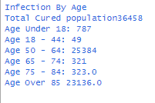
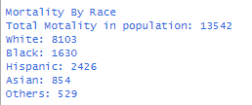
Running our Simulation for a population number of 50,000 the results are as follows

Slide 9
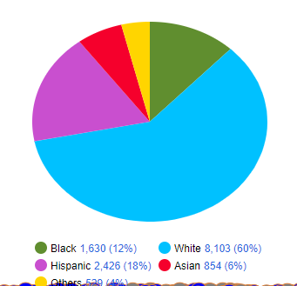
Mortality Rate Result By Race for a population of 50,0000

Slide 10
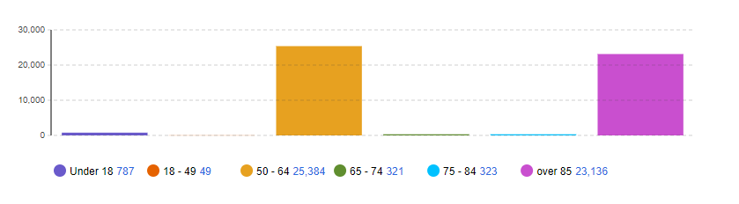
Infection agents Age Distribution for a population of 50,0000

Slide 11
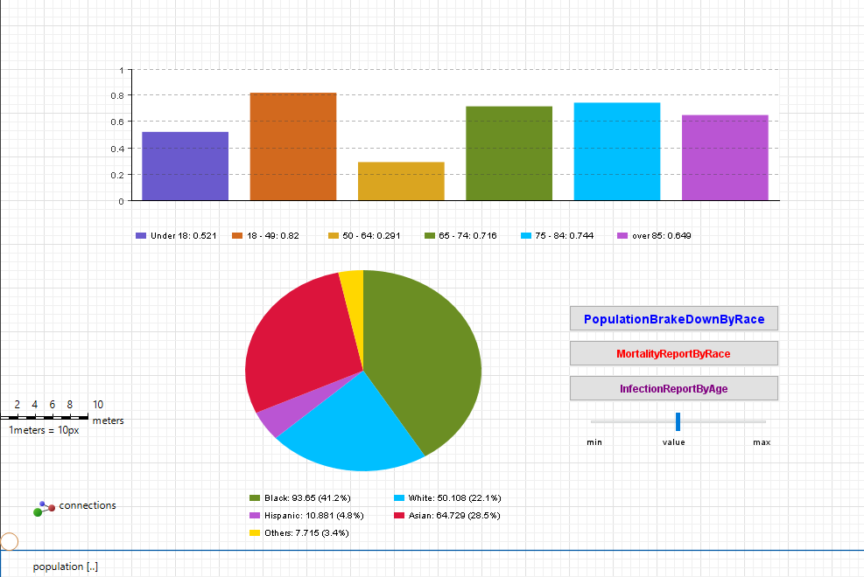

Slide 13
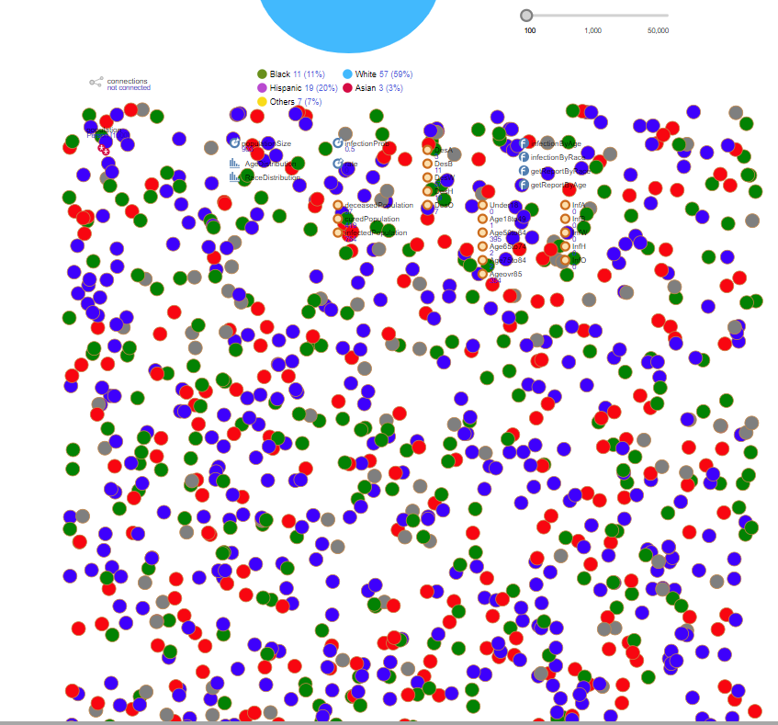

Slide 14
Demo Time

